Slide 1
Architecture
My SQL DB
Container
FHIR Connector
service
Java
FHIR
Container
Using:
Daniel Johnson’s FHIR server image (empty)
Patient
Web app
Portal container
Using:
html/css/js
Threejs
Blender objs
Flask/Jinja
python
Using:
MySQL
bash
Using:
Java/MySQL
HAPI FHIR
Bash, python
Nodejs, json
tag_loader
Done
Improvement needed
Not Started
Notes:
The connector app gets the patient list from the DB and uses it to get patients from the FHIR server on startup. Then connector app loads the patient data into the db.
The web app Interacts with the database only.
Languages: Python, Java, HTML/CSS/Javascript
Web App:
Languages
Python, HTML/CSS/Javascript.
Tools
Flask/Jinja - web page templating framework
3d Modeling - Three.js, blender
Database: MySQL
FHIR Connector service
Java on Ubuntu
HAPI APIs

Slide 2
Architecture
My SQL DB
Container
FHIR Connector
service
Java
FHIR
Container
Using:
Daniel Johnson’s FHIR server image (empty)
Patient
Web app
Portal container
Using:
html/css/js
Threejs
Blender objs
Flask/Jinja
python
Using:
MySQL
bash
Using:
Java/MySQL
HAPI FHIR
Bash, python,
json
Notes:
The connector app gets the patient list from the DB and uses it to get patients from the FHIR server on startup. Then connector app loads the patient data into the db.
The web app Interacts with the database only.
Languages: Python, Java, HTML/CSS/Javascript
Web App:
Languages
Python, HTML/CSS/Javascript.
Tools
Flask/Jinja - web page templating framework
3d Modeling - Three.js, blender
Database: MySQL
FHIR Connector service
Java on Ubuntu
HAPI APIs

Slide 3
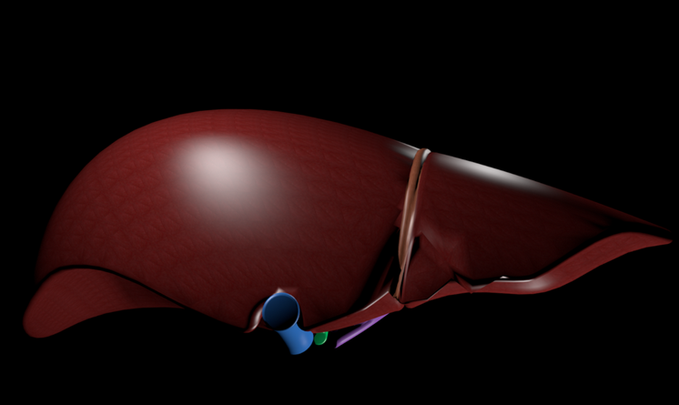
Patients
Patient 1
Patient 2
Patient 3
Patient 4
Patient 5
Condition
Fatty Liver Disease
Causes
Symptoms
Treatments
Description
Fatty liver is a reversible condition wherein large vacuoles of triglyceride fat accumulate in liver cells via the process of steatosis. Despite having multiple causes, fatty liver can be considered a single disease that occurs worldwide in those with excessive alcohol intake and the obese.
Normal
Advanced Stage
of Disease
Notes:
Jenn: FYI moved the ball to normal since this is a normal liver . Also removed the conversation bubbles Cheryl and I were having (adding it down here in case anyone’s curious)
-------------------------------
Cheryl: Not sure if this is right, but there’s this thing where you can select a topic that collapses the others and some pane shows the selected text. You folks familiar with that?(Tree List?-marcos >Cheryl: thinking more like collapsible list - http://materializecss.com/collapsible.html - accordion style) Or a list/drop down may be easier :)
Jenn: I’m fine with either- maybe we can have Rafay choose since he’s doing the CSS/styling implementation :)
Cheryl: Sounds good. I like the collapse/expand thing from a usability Standpoint in that everything is visible Though this would be an “advanced” Web feature :)
-------------------------------

Slide 4
Database Schema
Table: Patient
-------------------------------------------
Id (PK)
Patient Id
Patient First name
Patient Last Name
Table: PatientDisease
-------------------------------------------
Id(PK)
Patient Id(FK)
Snomed code for disease
Disease name
Disease description
Disease typical causes
Disease typical symptoms
Disease typical treatment
Patient Symptoms
Patient Treatment
Notes:
Jenn: moved this to it’s own slide.

Slide 5
Database Schema
Table: Disease
-------------------------------------------
Id(PK)
Snomed code for disease
Disease name
Disease description
Disease typical causes
Disease typical symptoms
Disease typical treatment
Table: PatientId
-------------------------------------------
Id (PK)
Patient Id
Table: Patient
-------------------------------------------
Id (PK)
Patient Id
Patient First name
Patient Last Name
Patient Snomed disease code or disease ID (FK?)
Patient Symptoms
Patient Treatment
Notes:
Here’s another schema option that’s more normalized, by putting patient items separate from disease items.
Makes it easier to query and load from the fhirConnector to the DB
Makes it easier to preload the DB from data files.

Slide 6
Architecture
Overview
On FHIR server startup, the server will be loaded with patients and condition information.
On DB startup, the educational content and patient list will be loaded into the DB.
On FHIR connector app startup, the app gets the patient list from the DB and uses it to get patients from the FHIR server. Then the connector app loads the patient data into the db.
The web app interacts with the database only. It retrieves patient data and educational materials.
Languages: Python, Java, HTML/CSS/Javascript
Web App:
Languages
Python, HTML/CSS/Javascript.
Tools
Flask/Jinja - web page templating framework
3d Modeling - Three.js, blender
Database: MySQL
FHIR Connector service
Java on Ubuntu
HAPI APIs
FHIR Server: Instantiate Daniel’s image and pre-populate it.

